Slide 1
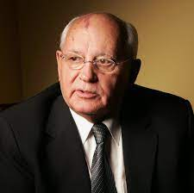

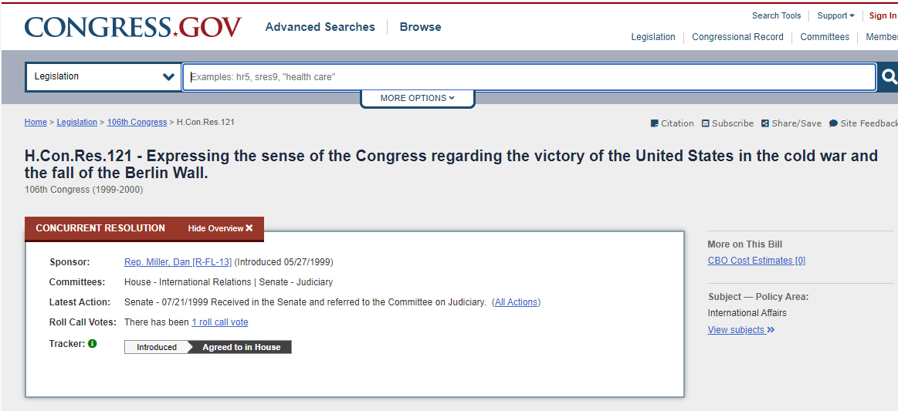
Michal Streams: At First I was skeptical, but know I know
Watson: Its in the CPU Performance
Dan Miller: (Introduced 05/27/1999)

Slide 2
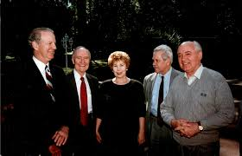
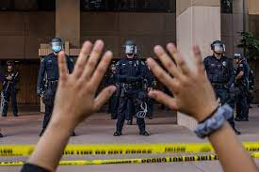
Michal Streams: At First I was skeptical, but know I know

Slide 3
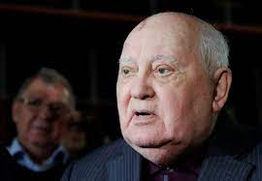
Michal Streams: At First I was skeptical, but know I know

Slide 4
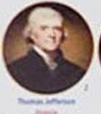
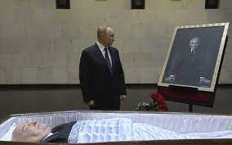
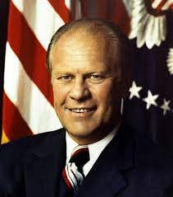
Michal Streams
for

Slide 5
